Slide 1
MTAT.03.231 Business Process Management Lecture 2 – Process Identification
Marlon Dumas
marlon.dumas ät ut . ee

Slide 2
Course structure
Week 2
Weeks 3-4
Weeks 12-14
Strategy
Gover-nance
Weeks 5-7
Culture
Weeks 10-11
Weeks 8-9
Notes:
Dopo aver visto cos’e’ BPM e perche’ e’ utile, legando BPM agli imperativi di management aziendale, vediamo COME BPM riesce a raggiungere tali obiettivi, cioe’ a produrre valore per un’organizzazione
Una serie di metodi: BPM lifecycle
Process identification = assegnare delle priorita’ alla gestione dei processi
Process monitoring and controlling = I processi in esecuzione, sia manuali che automatici, vengono monitorati al fine di controllare che le loro performance siano allieante alle nostre aspettative, e che I processi siano conformi alla struttura definita nei rispettivi modelli
Process modelling mainly takes place during process discovery, where we want to document the processes of an organization as-is
It also takes place during redesign, when we model the to-be processes and in implementation, where we convert these conceptual models that we have built so far into executable specifications, that can be carried out by a BPMS.
In this course we will focus on modelling conceptual as-is business processes. We will also cover the identification phase, by showing how we can get to a set of business processes through a process architecture.

Slide 3

Many years later, as he faced the firing squad, Colonel Aureliano Buendía was to remember that distant afternoon when his father took him to discover ice. At that time Macondo was a village of twenty adobe houses, built on the bank of a river of clear water that ran along a bed of polished stones, which were white and enormous, like prehistoric eggs. The world was so recent that many things lacked names, and in order to indicate them it was necessary to point to them with the finger.

Slide 4

Process identification
What?
Identify an organization’s business processes
Prioritize their management based on certain criteria
Why?
Understand the organization
Maximize value of BPM projects
Notes:
Systematically define…
Establish clear criteria to…, i.e. for modelling, analysing, redesigning, automating and monitoring processes
Boundaries, i.e. the scope of each process with respect to the other processes
Process identification is a set of activities aiming to systematically define the set of
business processes of a company and establish clear criteria for prioritizing them.
The main output of process identification is a process architecture, which represents the
business processes and their interrelations. A process architecture serves as a framework
for defining the priorities and the scope of process modeling and redesign
projects.
WHY PROCESS IDENTIFICATION?
The first reason, related to the first aim, is UNDERSTANDING (the very first value we generate with BPM – transparency. And identification is the first step towards achieving that). The second reason, related to the second aim, is BUDGET, or better VALUE FOR MONEY.
Few organizations have the resources required to model all their processes in detail, to rigorously analyze and redesign each of them, to deploy automation technology in order to support each of these processes, and finally to continuously monitor the performance of all processes in detail. Even if such resources were available, it would not be cost-effective to spend them in this way. BPM is not free. Like any other investment in a company, investments in BPM have to pay off. Thus, it is imperative in every organization engaged in BPM to focus the attention on a subset of processes, i.e. to prioritize.
REASONS FOR PRIORITIZING
Some processes need to receive priority because they are of strategic importance to an organization’s survival. Other processes might show striking problems, which should be resolved for the sake of all involved stakeholders. In other words, the processes that an organization should focus on are found in areas where there is either great value created or significant trouble present (or both). To make things more complex, the subset of high-priority processes in an organization is subject to the dynamics of time: what may be processes that are of strategic importance to an organization at some point may grow less important as time elapses. Market demands may change and new regulations or the introduction of new products may limit what was once a profitable business activity. For example, the arrival of new competitors offering discount insurance policies through Web-based channels may push an established company to redesign its insurance sales processes to make them leaner, faster, and accessible from the Web.
However, while some processes may be problematic at one point, once the issues have been identified and resolved by a process improvement project, an organization can do with only periodic inspections for some time. For example, an insurance company suffering from high levels of customer dissatisfaction will naturally tend to focus on its customer-oriented processes, say its claims handling process. Once this process has improved and customer satisfaction is again within the desired range, the emphasis might move to its risk assessment processes, which are important for the long-term viability and competitiveness of the company.

Slide 5
Process identification steps
Designation step
Enumerate main processes
Determine process scope
Prioritization step (aka Process selection)
Prioritize processes based on:
Importance
Health
Feasibility
Process Architecture
Prioritized Process Portfolio
After Davenport (1993)
Notes:
Scope = l’ambito d’azione, in particolare quali sono le interrelazioni sia di ordine che gerarchico tra I processi in esame ed altri processi in esistenza nell’organizzazione
Feasibility = predisposizione di tali processi ad essere migliorati. Qui vanno presi in considerazione aspetti culturali e politici
Designation phase: what processes are executed in our organization
Boundaries and interrelationships = process scope
Prioritization (aka Evaluation phase, aka Process Selection): based on this information, which processes should the organization focus on in terms of management activities (modelling, redesign, automation, monitoring)?
Process scope : boundaries and interrelationships
Culture, e.g. the participants of a particular process are negatively affected by the way they are mandated to perform a given process (e.g. a suboptimal way), and start deviating from that
Importance
Which processes have the greatest impact on the organization‘s strategic goals?
Dysfunction
Which processes are in the deepest trouble?
Feasibility
Which process is the most susceptible to successful process management?
The evaluation can be carried out through a process portfolio diagram
The second point is about the health of a process. Which processes perform the worst? Which ones are less conformant with policies and regulations? Which ones are the less suistainable?
The third point is related to the susceptibility of a process to incidental or continuous process management initiatives, i.e. redesign, automation etc. BPM should focus on those processes where it is reasonable to expect benefits

Slide 6
Process Enumeration
“Most businesses have just three core processes:
Sell stuff
Deliver stuff
Making sure you have stuff to sell and deliver”
Geary Rummler

Slide 7
Porter: Types of processes
Management Processes
Core Processes
Suppliers / Partners
Customers / Stakeholders
Support Processes
After Michael Porter (1985)
Notes:
When doing enumeration, it helps classify the processes according to the structure of the process architecture that we are going to deliver at the end of process identification.
Porter contributed the distinction between types of processes. He defined Core and Support processes. Later, Management processes were added by other authors. As a strong generalization, operational processes should add value in a step-by-step progression. Management and support processes, on the other hand, are more likely to be necessary but non-value adding processes (not sufficient).
Core (si interfacciano direttamente con l’utente) = adempimento di un ordine
Support (forniscono le risorse in supporto ai core) = ordinare furniture
Mgt (forniscono direzione, regole e pratiche aziendali) = acquisire e gestire I fornitori
Note: suppleirs/partners and customers/stakeholders are not necessary but can help

Slide 8
Example: core, support and management processes
Wholesaler
Core processes
Sales (lead-to-quote, quote-to-order, order-to-cash)
Purchase-to-Pay (direct procurement, e.g. supplies replenishment)
…
Support processes
Purchase-to-pay (indirect procurement, e.g. parts replenishment, operational resources replenishment…)
HR (policies update, recruitment, induction, probation…)
…
Management processes
Suppliers management (suppliers planning, suppliers acquisition…)
Logistics management (logistics planning, logistics controlling…)
…
Notes:
Warehouse management include space optimization…
---
Procurement (procure-to-pay or purchase-to-pay):
Procurement materials can be broken down into two major categories: indirect and direct.
Indirect procurement involves any commodity or service that a company buys that does not result directly in finished goods. Indirect procurement can be divided into two groups: ORM (Operations Resource Management) materials such as office products and travel services, and MRO (Maintenance, Repair and Operations) materials such as replacement parts.
Direct procurement involves materials purchased for use in the manufacturing or distribution supply chain that are "directly" related to the production of finished goods.
With e-procurement, the traditional division between direct and indirect purchasing paths is beginning to blur.
Traditionally, procurement has been broken down into two major categories: indirect and direct. In general terms, indirect procurement describes all of the day-to-day necessities of the workplace—staplers, paper, furniture, laptop computers, pencils, travel services—those things that tend to be of low value per item, but are usually bought in high volumes.

Slide 9
Relations between core, support, mgt processes

Slide 10
Example: process architecture
Wholesaler
Strategic Management
Logistics Management
Suppliers Management
Warehouse Management
Demand Management
Process group
Management processes
Direct
procurement
Sales
Distribution
Marketing
Service
Core processes
Finance
Indirect
procurement
IT
HR
Support processes
Notes:
(at this stage we haven’t yet illustrated the value chain notion, so we have boxes with process groupings, not yet value chains – so no chevron notation)
Each box represents a process grouping (later we will say each may include one or more value chains)
Note that risk assessment & management is a core process for this insurance company, as an HR company would have HR as their core process (aside form the internal HR services)

Slide 11
Example: process architecture
Insurance company
Strategic Management
Corporate Development
Market Development
Investor Relations
Management processes
Risk Assessment & Management
Marketing & Sales
Underwriting
Management
Policy Servicing
Claims Management
Payments Collection and Disbursement
Assets Management
Core processes
Finance/
Treasury
Legal/
Audit
Reinsurance
IT
HR
Support processes
Notes:
Each box represents a process grouping (later we will say each includes to one or more value chains)
Note that risk assessment & management is a core process for this insurance company, as an HR company would have HR as their core process (aside form the internal HR services)

Slide 12
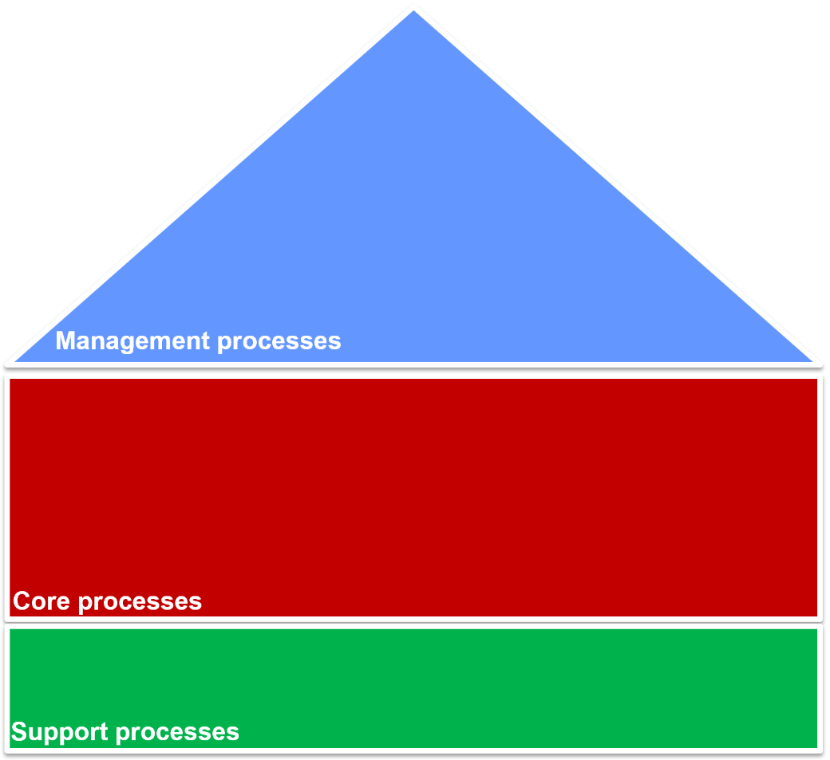
Exercise: classify by process type
These groups of processes are typically performed at a university. Categorize each process group as core, support or management
Sport
services
HR
Indirect
procurement
Strategic Management
Teaching award courses
IP Management
Marketing
Course Management
Additional services mgt
Language
training
Admission
IT
Market
management
Teaching professional courses

Slide 13
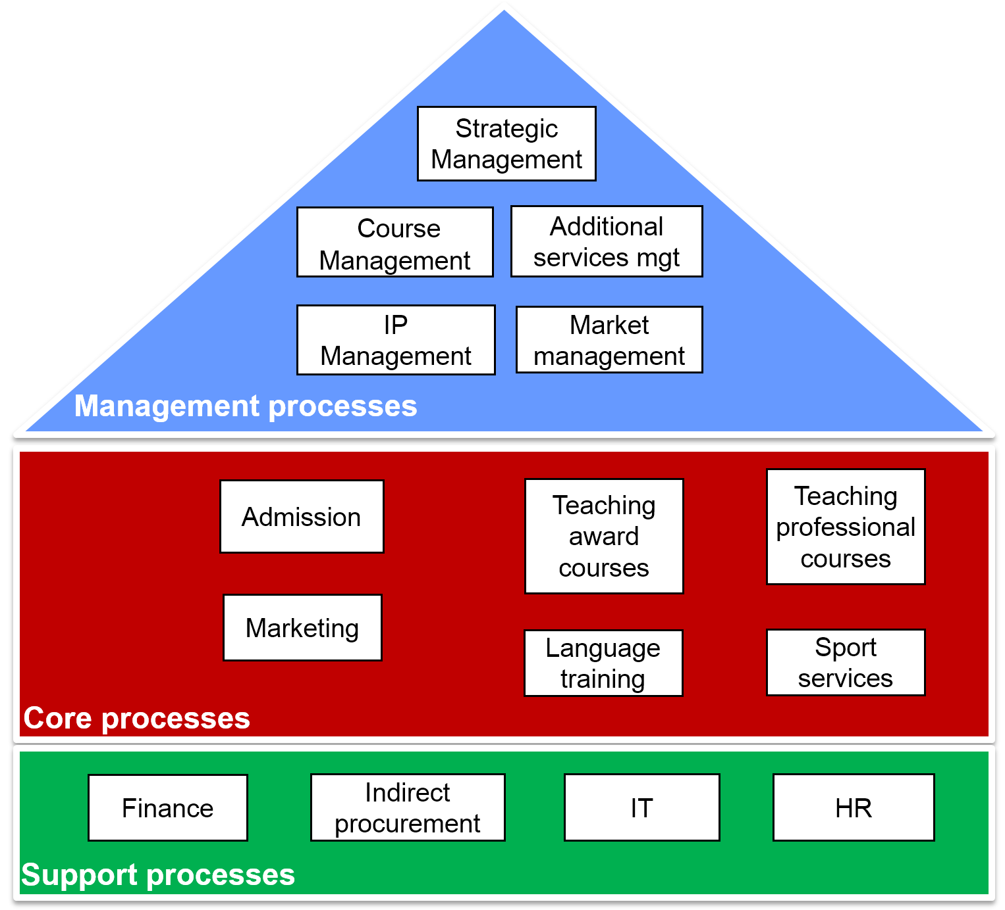
Solution: identify process types
Notes:
A university’s core business revolves around teaching. Admission and marketing processes are also very important to guarantee a constant inflow of students to the courses. Language training and sport services are complementary services offered to the students, with the former being mandatory for international students who do not satisfy the language requirements upon admission. Hence these process groups are also core. Finance, indirect procurement, IT and HR are clearly groups of support processes for a university, as they are for any medium-to-large size business. As for the management processes, besides strategic management, which is not domain-specific, a university needs to manage its courses and additional services, the market (e.g. through engagement of international and local agents), and protect its IP.

Slide 14
Process scoping
Processes are interdependent → insights into interrelations required
Specialization: general – special product/service
Horizontal: upstream – downstream processes and their value chains
Vertical: main processes – sub-processes
Process architecture
Notes:
Remember:
Exploratory and iterative identification = that’s why we say that managing a process IS a lifecycle
Time-constrained improvements = we may look at agile improvement approaches (i.e. release updates periodically, rather than do everything in one go). It’s also important to complete the lifecycle rather than getting stuck for too long in one phase to do it perfectly

Slide 15
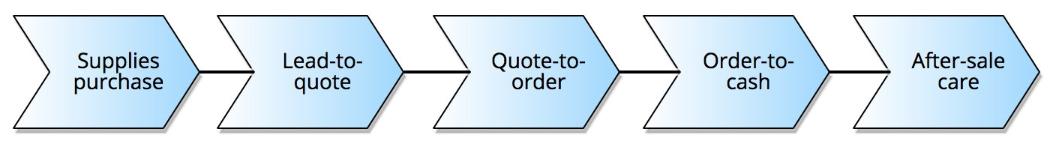

Value chain modeling
Chain of processes an organization performs to deliver value to customers and stakeholders
More generally, a mechanism to group high-level business processes according to an order relation (can be applied to core, support and management processes)
business
process
Procure-to-service
order relation
Notes:
This way of thinking of incremental changes in outcome/resolution or in the achievement of an objective is by modeling value chains
[One way to scope a process horizontally, as well as to identify specialization relations, is with value chain modeling
Horizontal relationships can be modeled via value chains, which provide a way to scope processes horizontally]
Say where it originates from
a business goal, e.g. deliver a product or service to the market
Stepping back from the specifics, the value chain is about optimization. The whole approach is predicated on the idea that a firm ought to have a clear goal – to produce a specific product or service – and that they then ought to do everything they can to optimize the efficiency and effectiveness with which they do it.
Introduce Principle of Optimization (Don’t allow sub-optimization)
yes, so we can say "strictly speaking" the notion of value chain relates to a chain of core processes that generate value to a customer. However, the same notion can be applied to decompose support services where we move from a need to a resolution, or management services
Chevron notation: not necessarily sequential, there can be decisions and coming back. It originates from ARIS
Value stream or end-to-end business scenario
In the ARIS toolset, the term "Value-added Chain Diagram” (VACD) or (VAD) has been used to model this notion of value chain and then more generally, to model any sequence of high level business processes that are performed to achieve a goal (e.g. the risk management chain in slide 25). Nowadays, with the term "value chain" we more generally indicate any such sequence of high-level processes, not necessarily those that directly generate value by delivering a product or service to customers. The VACD is only a notation to visually represent these value chains in ARIS.

Slide 16

Guidelines to identify horizontal boundaries in value chains
Change of key business object in the process
Change of granularity of main business object
Change in frequency/time
Change in intermediate outcome/resolution/objective
Notes:
Quote, Purchase order
2. Mortgage application (one mortgage), Mortgage payment (multiple mortgages processed in batch at the end of the month): so we can divide between Loan application assessment (loan origination) and Loan repayment processes
3. Performed at different time intervals, e.g. every day (interest calculation), month (payment), year (fees collection)
(4. Note that the space separation needs to imply differences in the logic of the process: if two processes are just performed at two different locations it doesn’t necessarily mean they are separated. It can just be two variants. On the other hand, if e.g. two different environments play a role in the determination of the process logic, e.g. NL and Belgium have different legislations, then this is an indicator for separating the process into two per location)
Note: the first three guidelines are generic, the forth is specific to the type of process (core, support and mgt) – see next slide
5. According to the action-workflow theory, we distinguish between four transactional states: initiation, negotiation, execution, acceptance

Slide 17
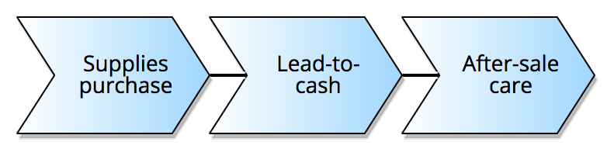
Example: value chain
Wholesaler
Core processes
Notes:
The core processes that we have seen for the wholesaler can be grouped according to a value chain, where we order them from the inputs (the fresh produce from the suppliers) all the way to the output (the products) sold to the retailers (the wholesaler’s customers), in order to generate value for the retailers
After-sale care includes product return, merchandise loss
One could add a “campaign-to-lead” before “lead-to-quote”
Value chain: Replenish stocks, lead-to-quote, quote-to-order, order-to-cash, after-sale services
lead-to-cash: lead-to-quote, quote-to-order, order-to-cash
then order-to-cash goes into "order verification", "order production" "order shipment", "invoicing" "payment collection“

Slide 18
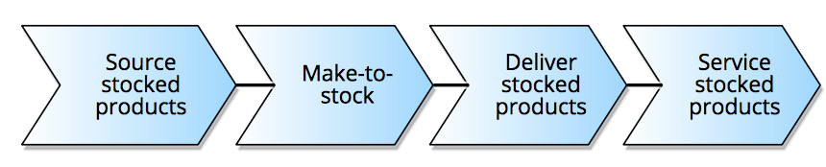
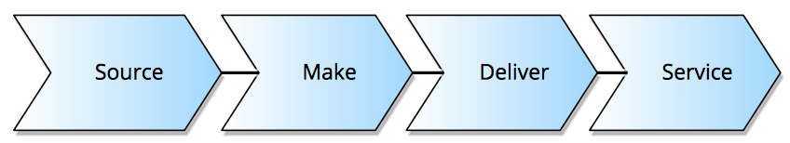
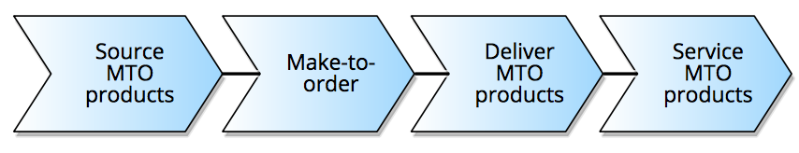
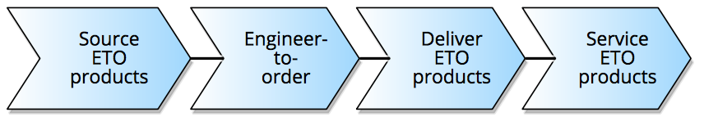
Typical value chains for core processes
Think around three main steps:
Imagine it (design new product/service)
Build it (source, assemble, deliver product/service)
Sell it (market, sell, service product/service)
Example: Producer
Stocked products:
MTO products:
ETO products:
Specializations
Notes:
One way to think of a value chain of core processes is to imagine it around three main steps:
Not necessarily in this order (imagine, build, sell)
Another example is Michelin: a producer that sells tires and restaurant guides which has two main value chains (externally they go through the same steps, internally quite different).
MTS: through demand forecast, source materials are acquired and products are made to stock, i.e. to be kept in stock, they are not made on the basis of the receipt of an individual order. Example: iphone
MTO (or build to order): for highly customized and low volume products. Example: Porche that is built on demand
ETO: for products where after an order is received, a part of or the whole design is done: Example: custom-shop guitar co-designed with an artist

Slide 19
Example: value chains for service provider
IT service provider
Notes:
In the case of a service organization, say a financial organization, the typical value chain goes over these core processes:
Design new service, market, sell, deliver and service the service
Note that each value chain provides a different service and refers to a different type of customer, e.g. Systems Integration sells software development services, whereas Outsourcing manages the execution of other companies’ software applications, etc.
Similarly, a financial institution would have: loans, banking, investments management, pensions…
And the notion of specialization clearly also applies to service providers. For example, an insurance company would have: home insurance, motor insurance, commercial insurance etc (one value chain for each line of business) where these are all specialization of the value chain to manage claims: product dev, sales, (service,) claims.

Slide 20
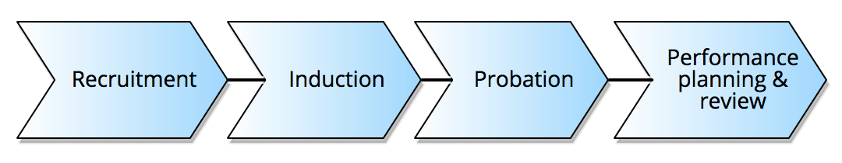
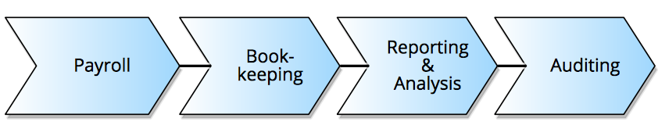
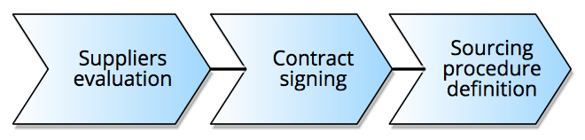
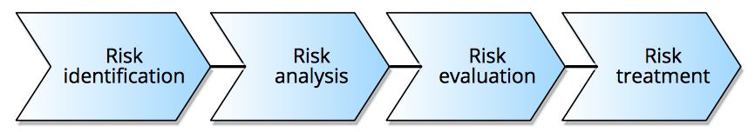
Example: value chain of non-core processes
Support processes
HR:
Accounting:
Management processes
Suppliers
management:
Risk
management:
Notes:
bookkeeping, preparation and analysis of financial statements (e.g. for tax purposes), payroll services, payment services, management accounting, business advice and planning, auditing

Slide 21
Example: process architecture & value chains
Wholesaler
Strategic Management
Warehouse Management
Logistics Management
Suppliers Management
Demand Management
Management processes
Chevron: collapsed value chain
Box: groups
processes/ value chains
Direct
procurement
Sales
Distribution
Procure-to-Service
Marketing
Service
Core processes
Finance
Indirect
procurement
IT
HR
Support processes
Notes:
Each chevron is a collapsed value chain, each box is a group of processes and/or value chains. E.g. HR contains the value chain recruitment-induction-probation-PPR, as well as processes such as training that are not necessarily part of a value chain

Slide 22
Alternative: process architecture – groups
Consultancy Firm
Expanded
process group
Notes:
Each colored box is a group of processes (not necessarily a value chain), each white box is a business process

Slide 23
Typical artifacts for vertical scoping
Value chains
Chains of processes. Stay at a high level. Rule of thumb: 3-7 processes
Procure-to-service, Risk management
(Root/Main) Processes
Build up value chains and affect each other. They are abstract
Lead-to-quote, Quote-to-order, Order-to-cash
Subprocesses
Build up processes. They are detailed, involve multiple activities and can be layered on different levels of abstraction (i.e. sub-subprocesses)
Order shipment, invoicing
Process tasks
Build up processes and sub-processes. They are atomic and performed by human beings, IT systems or equipment
Approve invoice
Typical focus of Process enumeration
Notes:
When it comes to vertical scoping, we need to identify relations between different types of artifacts
Process enumeration typically applies to root/main processes and their grouping into value chains
Tasks: Approve invoice done by a financial officer using a system, e.g. an ERP
---
Sub-process: sales operation, preparation of sales budget, reception of customer orders.
For example: reception of customer orders involves review of these orders and incorporating them into the system.

Slide 24
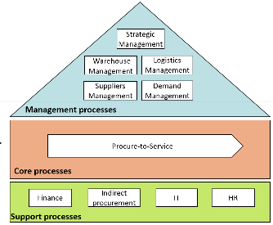

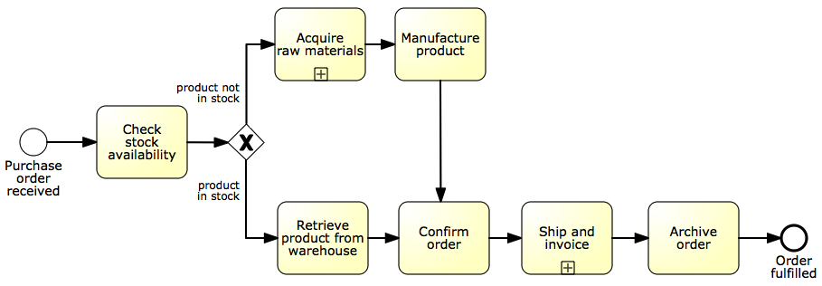
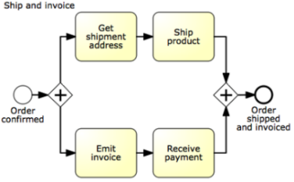
Process architecture: hierarchical view
Level 1
Process
Landscape
Level 2
Main Processes
(e.g. BPMN)
Process hierarchy
Level 3+
Subprocesses, Tasks
(e.g. BPMN)
Notes:
Note that building the actual process model goes beyond the scope of process identification, and thus a typical process architecture at this stage limits itself to listing the processes and subprocesses as boxes.
Level 1 – start with value chain
Level 2 – add main decisions and handoffs (lanes)
Level 3+ – add procedural aspects:
Parallel gateways
Data objects, data stores
Exception handling
And as much detail as is relevant
Quote handling
Product delivery
Invoice handling
order verification", "order production" "order shipment", "invoicing" "payment collection

Slide 25

How many levels in the process architecture?
Notes:
There’s no rule fits all, it’s a decision that depends on inherent complexity of the organization, focus of the identification/BPM initiative, and conventions established

Slide 26
Example: hierarchical process architecture
Insurance company
Level 1
Strategic Management
Corporate Development
Market Development
Investor Relations
Management processes
Risk Assessment & Management
Marketing & Sales
Underwriting
Management
Policy Servicing
Claims Management
Payments Collection and Disbursement
Assets Management
Core processes
Finance/
Treasury
Legal/
Audit
Reinsurance
IT
HR
Support processes
Notes:
Let’s come back to our example process architecture for an insurance company. This architecture is structured over five levels of abstraction, as follows:
Level 1: process landscape with process groups
Level 2: process subgroups
Level 3: main processes
Level 4: subprocesses
Level 5: tasks
[show figure]

Slide 27
Example: hierarchical process architecture
Insurance company
Level 2
Strategic
Management
Corporate
development
Marketing
development
Investor
relations
Process
group
Define
business concept &
long-term vision
Design & manage
corporate policies
Define offering and customer value proposition
Plan
investor
relations
Process
subgroup
Develop
business
strategy
Manage
knowledge
Define pricing
strategy
Build
investor
relations
Manage
strategic
initiatives
Manage
change & improvement
Define and manage
channel strategy
Manage
investor
relations
Manage
partners
Communicate
with stakeholders
Manage
investments &
divestments
Management processes
Notes:
For example, if we take a closer look at the groups of management processes, namely Strategic management, Corporate development, market development and investor relations, we can find these process subgroups on Level 2: [show Figure]

Slide 28
Example: hierarchical process architecture
Insurance company
Develop
business strategy
Define offering and customer value proposition
Process
subgroup
Develop overall
mission statement
Define
offering and
positioning
Main
process
Evaluate strategic
options
Develop value
proposition
Level 3
Select
long-term business
strategy
Validate value proposition
Coordinate
functional and operational strategies
Develop
new branding
Align
functional and operational strategies
Create organisational
design
Develop organisational
goals
Formulate
business unit
strategies
Management processes
Notes:
Likewise, if we drill down into the subgroups “Develop business strategy” under “Strategic management” or “Define offering and customer value proposition” under ”Marketing development”, we can find the following main processes and so on: [show figure]

Slide 29
Example: hierarchical process architecture
Insurance company
Level 4
Develop overall
mission statement
Main
process
Define
current business
Subprocess
Formulate
mission
Communicate
mission
Management processes
Notes:
One could already identify subprocesses as shown above for the main process “Develop overall mission statement”, as well as individual process tasks, as part of a process hierarchy. However this is typically done during the process discovery phase, when the business processes are modelled and input from process discovery can then be used to enrich the process hierarchy. Alternatively, this information may be already available during the process identification phase, if using a reference model, as we will see next.
In any case, this is why we say that process identification is an iterative step.

Slide 30
Designation via reference models
A reference model is used as a template to design the process architecture
Examples:
Information Technology Infrastructure Library (ITIL)
Supply Chain Operations Reference Model (SCOR)
Process Classification Framework (PCF)
Control Objectives for Information Technology (COBIT)
Value Reference Model (VRM)
Voluntary Interindustry Commerce Solutions (VICS)
eTOM Business Process Framework
Performance Framework
Notes:
Reference models standardize what can be seen as different processes, with unique characteristics and delivering distinguishable products, and how their performance can be measured. Their largest value is in the identification of regulatory or highly industry-specific processes, or when performance
SCOR by by the Supply Chain Council
PCQ by APQC
VRM by the Value Chain Group
eTOM by TM (TeleManagement) Forum
Performance Framework by Rummler–Brache

Slide 31
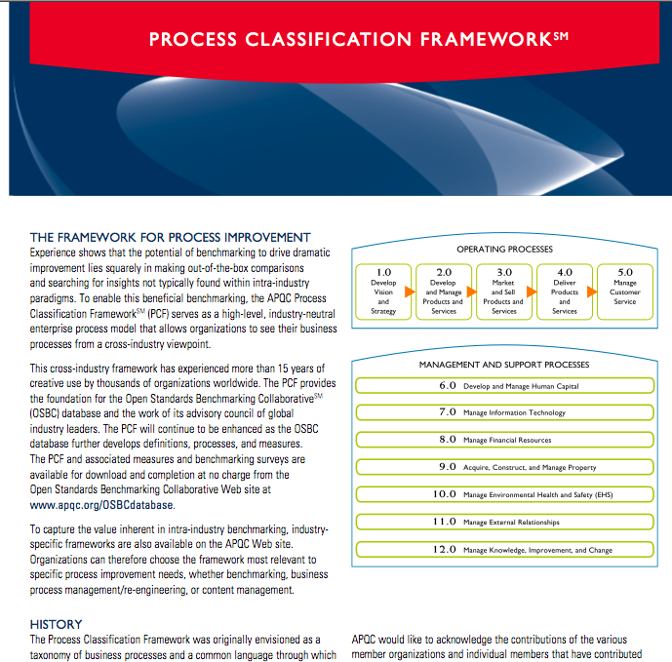
Example: APQC Process Classification Framework (PCF)
Industry-neutral enterprise model
Open standard for benchmarking
Four levels
Categories
Process group
Process
Activity
Notes:
The APQC (American Productivity & Quality Center) Process Classification Framework (PCF) serves as a high-level, industry-neutral enterprise process model that allows organizations to see their business processes from a cross-industry viewpoint.
Latest version (2013) is v.6

Slide 32
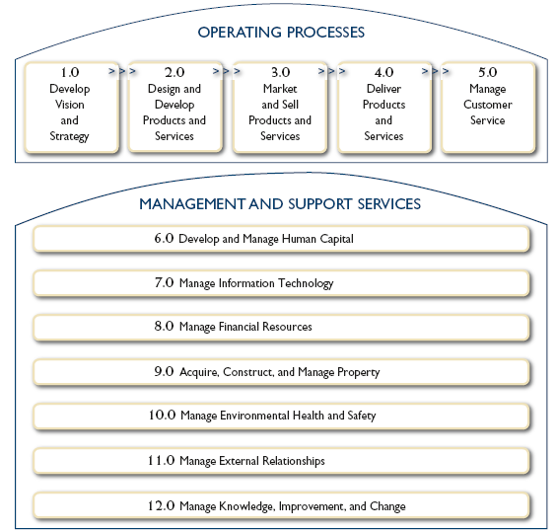
APQC PCF Overview
Category

Slide 33
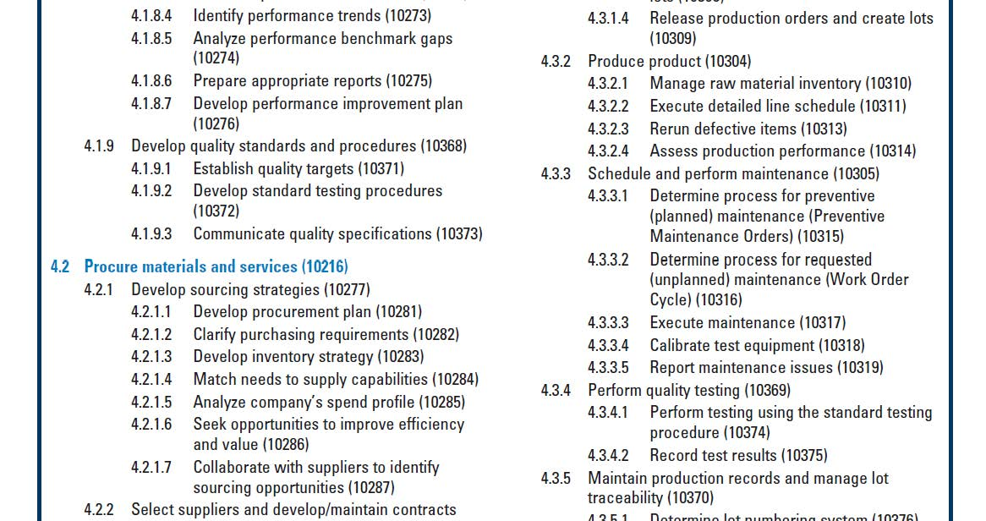
APQC Classification Framework
Group
Activity
Process
Notes:
By activity we mean both subprocess and task

Slide 34
Prioritization (aka Process Selection)
Importance
Which processes have greatest impact on the organization‘s strategic objectives?
Health (or Dysfunction)
Which processes are in deepest trouble?
Feasibility
Which processes are most susceptible to successful process management?
Prioritized process portfolio
Hammer, Champy (1993)
Notes:
The evaluation can be carried out through a process portfolio diagram
The second point is about the health of a process. Which processes perform the worst? Which ones are less conformant with policies and regulations? Which ones are the less suistainable?
The third point is related to the susceptibility of a process to incidental or continuous process management initiatives, i.e. redesign, automation etc. BPM should focus on those processes where it is reasonable to expect benefits

Slide 35
Example: prioritized process portfolio
Financial institution
Short-term action
High
Rating
Feasibility
Loan
controlling
Contract
preparation
Low
Loan
decision
Medium
Loan market
evaluation
High
Importance
Handling of
payments
Loan
planning
Loan
application
Low
Poor
Possible
Health
Strategic fit?
Good
Notes:
Possible = potential for outsourcing, esp. those that cannot be easily changed, such as handling of payments. Note, they are strategically not very important
Importance
Dysfunction
Feasibility = For each process, it should be determined how susceptible they are to process management initiatives, either incidental or on a continuous basis. Most notably, culture and politics involved in a particular process may be obstacles to achieve results from such initiatives. In general, process management should focus on those processes where it is reasonable to expect benefits. [CULTURE & PEOPLE]
Clearly, the three aspects of importance, dysfunction and feasibility are fully orthogonal.
3 messages:
Not too many projects in parallel because it’s too costly (time, resources)
Not too many projects in parallel because of increased coordination complexity (processes are interrelated)
Don’t tackle for first the process that is the most strategically important and dysfunctional, because you will have high chances of failure. Rather, start with a small number of projects as Davenport say, and learn from these
Should all processes that are dysfunctional, of strategic importance, and feasible to manage be subjected to process management initiatives?
The general answer to this question is that for most organizations this is not feasible. Recall again that process management consumes resources. Even when there is a clear incentive to, for example, redesign various existing business processes, most organizations lack sufficient resources—people, funds, and time—to do so. Only the largest organizations are able to support more than a handful of process improvement projects at the same time. A good case in point is IBM, an organization known to have process improvement projects going on within all its existing business processes on a continuous basis. Another caveat of carrying out many simultaneous process management efforts is that these will create coordination complexity. Remember that processes may be linked to each other in various respects, such that measures taken for one process should be synchronized with those taken for other. As Davenport [10] describes: Most companies choose to address a small set of business processes in order to gain experience with innovation initiatives, and they focus their resources on the most critical processes. Each successful initiative becomes a model for future efforts.
What is happening in some organizations is that widespread efforts are made to at least model all important business processes, delaying the decision to make the step to more advanced BPM efforts (e.g. process redesign or automation). The idea is that process models are a cornerstone of any further BPM efforts in any case and that their existence will help to better understand where improvements can be gained. Creating a model of a process leads to the valuable insight how that process works at all, and can provide a good basis for small improvements that can easily be implemented. On the downside, such an approach bears the risk that major improvements are missed and stakeholders develop a feeling of a lack of return for the efforts. It should be stressed here, too, that the actual modeling of business processes is not an element of the process identification stage.
---
Note that it may very well be that a strategically important process is also the process that can be expected to be the most difficult one to manage, simply because so many earlier improvement efforts have already failed. An organization may not have a choice in such a situation. If a strategic process cannot be improved, this may turn out to be fatal for an organization as a whole. Think of a situation where the process to come up with new products creates much turmoil and conflicts within an organization: If the issues cannot be sorted out, the company may stop functioning quickly. In other settings, it may be more important to gain credibility with process management activities first. This can be accomplished by focusing on problematic processes of milder strategic importance but where there is a great desire to change. If successful, an improvement project at such a place may give credibility to the process management approach. These are not choices that can be easily prescribed without taking the specific context into situation. The various evaluation outcomes should be balanced to reach a list of those processes that should receive priority over others.

Slide 36
Prioritization
Importance
Which processes have greatest impact on the organization‘s strategic objectives?
Health (or Dysfunction)
Which processes are in deepest trouble?
Feasibility
Which processes are most susceptible to successful process management?
Prioritized process portfolio
Hammer, Champy (1993)
Notes:
The evaluation can be carried out through a process portfolio diagram
The second point is about the health of a process. Which processes perform the worst? Which ones are less conformant with policies and regulations? Which ones are the less suistainable?
The third point is related to the susceptibility of a process to incidental or continuous process management initiatives, i.e. redesign, automation etc. BPM should focus on those processes where it is reasonable to expect benefits

Slide 37
Example: prioritized process PICK chart
Financial institution
Short-term action
High
Rating
Feasibility
Loan
controlling
Contract
preparation
Low
Loan
decision
Medium
Loan market
evaluation
High
Importance
Handling of
payments
Loan
planning
Loan
application
Low
Poor
Possible
Health
Strategic fit?
Good
Notes:
Possible = potential for outsourcing, esp. those that cannot be easily changed, such as handling of payments. Note, they are strategically not very important
Importance
Dysfunction
Feasibility = For each process, it should be determined how susceptible they are to process management initiatives, either incidental or on a continuous basis. Most notably, culture and politics involved in a particular process may be obstacles to achieve results from such initiatives. In general, process management should focus on those processes where it is reasonable to expect benefits. [CULTURE & PEOPLE]
Clearly, the three aspects of importance, dysfunction and feasibility are fully orthogonal.
3 messages:
Not too many projects in parallel because it’s too costly (time, resources)
Not too many projects in parallel because of increased coordination complexity (processes are interrelated)
Don’t tackle for first the process that is the most strategically important and dysfunctional, because you will have high chances of failure. Rather, start with a small number of projects as Davenport say, and learn from these
Should all processes that are dysfunctional, of strategic importance, and feasible to manage be subjected to process management initiatives?
The general answer to this question is that for most organizations this is not feasible. Recall again that process management consumes resources. Even when there is a clear incentive to, for example, redesign various existing business processes, most organizations lack sufficient resources—people, funds, and time—to do so. Only the largest organizations are able to support more than a handful of process improvement projects at the same time. A good case in point is IBM, an organization known to have process improvement projects going on within all its existing business processes on a continuous basis. Another caveat of carrying out many simultaneous process management efforts is that these will create coordination complexity. Remember that processes may be linked to each other in various respects, such that measures taken for one process should be synchronized with those taken for other. As Davenport [10] describes: Most companies choose to address a small set of business processes in order to gain experience with innovation initiatives, and they focus their resources on the most critical processes. Each successful initiative becomes a model for future efforts.
What is happening in some organizations is that widespread efforts are made to at least model all important business processes, delaying the decision to make the step to more advanced BPM efforts (e.g. process redesign or automation). The idea is that process models are a cornerstone of any further BPM efforts in any case and that their existence will help to better understand where improvements can be gained. Creating a model of a process leads to the valuable insight how that process works at all, and can provide a good basis for small improvements that can easily be implemented. On the downside, such an approach bears the risk that major improvements are missed and stakeholders develop a feeling of a lack of return for the efforts. It should be stressed here, too, that the actual modeling of business processes is not an element of the process identification stage.
---
Note that it may very well be that a strategically important process is also the process that can be expected to be the most difficult one to manage, simply because so many earlier improvement efforts have already failed. An organization may not have a choice in such a situation. If a strategic process cannot be improved, this may turn out to be fatal for an organization as a whole. Think of a situation where the process to come up with new products creates much turmoil and conflicts within an organization: If the issues cannot be sorted out, the company may stop functioning quickly. In other settings, it may be more important to gain credibility with process management activities first. This can be accomplished by focusing on problematic processes of milder strategic importance but where there is a great desire to change. If successful, an improvement project at such a place may give credibility to the process management approach. These are not choices that can be easily prescribed without taking the specific context into situation. The various evaluation outcomes should be balanced to reach a list of those processes that should receive priority over others.

Slide 38
Further Readings & Resources
Fundamentals of Business Process Management
Chapter 2 – Process Identification

Slide 39
Next Week
Process Modeling

